Slide 1
PLT: Week 5
Chomsky

Slide 2
Table of Contents
Chomsky:
  English
  Abstract-substitution generation

Slide 3
Overall Sentence Structure
Instances:
    The cat chased the big rat
    The big dog hit the big helpful frog
    A frog caught a big black helpful cat
Productions
    S-> PVP
    P->AN
    P->AQN
    Q->D
    Q->DQ
    A->some, A->a, A->the
    D->big, D->black, D->helpful
    N->cat, N->rat, N->dog, N->frog
    V-> hit, V->chased, V->caught
Notes:
<νυμβερ>
Natural Language and abstraction-substitution principle

Slide 4
Other Contributions: (Terminology & Types)
Terminology:
  4-tuple {V_{T}, V_{N}, P, S}
Types:
  Unrestricted Grammars:
    α -> β
    Otherwise no restrictions
  Context Sensitive Grammars:
    α -> β
    | α| !> |β|
  Context Free Grammars:
    A-> β
    Α ε V_{Ν}
  Regular Grammars:
    A->aB
    A->B
    A->a
    A-> λ
Notes:
<νυμβερ>

Slide 5
Drunkard’s Lament: CF Grammar
CFG
  <Lament> -> <Article><Adjstuff><Noun><Verb> my drink
  <Lament> -> <Article><Noun><Verb> my drink
  <Article> -> Some | A | The
  <Adjstuff> -> <Adj><Adjstuff>
  <Adjstuff> -> <Adj>
  <Adj> -> rotten | lousy | dirty
  <Noun> -> swine | pig | rat
  <Verb> -> took | swiped | stole
RG:
  <Lament> -> Some <RestOfStuff>
  <Lament> -> A <RestOfStuff>
  <Lament> -> The <RestOfStuff>
  <RestOfStuff>->rotton <RestOfStuff>
  <RestOfStuff>->lousy <RestOfStuff>
  <RestOfStuff>->dirty <RestOfStuff>
  <RestOfStuff>->swine <VerbObject>
  <RestOfStuff>->pig <VerbObject>
  <RestOfStuff>->rat <VerbObject>
  <VerbObject> ->took…
Notes:
<νυμβερ>
Note the conventions: using mnemonic titles, and ‘ors’
Get them to do it after I give them line 1

Slide 6
Chomsky Great Leap:
From Gen. To Parsing
Parsing;
  Can we move, using the production rules, from the start symbol to a pre-defined language instance;
  Can we apply the production rules in reverse to work back up to the start symbol from the language instance;
  If we thus establish at least 1 sequence of application of production rules…;
  If we prove we can’t establish a sequence of application of production rules…:
Notes:
<νυμβερ>
Looking to generate sentences, starting at the start symbol, going through sentential forms by applying production rules, until the sentential form contains no non-terminals and thus becomes a language instance.
Parsing: given a language instance (a string of terminal symbols), can we establish if the language instance is a structurally valid construct of that language.
Note, the 2 options on the slide suggest a top-down approach or a bottom-up approach.
Production rules in reverse means going from the rhs to the lhs and working our way back up to the start symbol
Illustrate the 2 options by means of the grammar over leaf
There can be several different parses (sequences of applications of production rules based on whether)
1: We consider it from the top-down or bottom-up perspective;
2: Even within these, it depends on the vocabulary element(s) we choose;
3: Again within these, it depends on which production rule we decide to apply when;

Slide 7
Top-Down LD Parsing: Automation via the Predict set
Based On Grammar:
  E-> vT
  E-> P(E)
  P-> λ
  P-> f
  T->+E
  T->λ
Top-down, Leftmost Derivation of validity of f(v+v):
  First and follow set for each rule
  Look-ahead to see what comes next
  Starting at the start symbol, match them…
Notes:
<νυμβερ>
Top Down Parsing:
Starting at Parse Tree Root;
Corresponds to Leftmost Derivation;
Non Determinism / Backtracking:

Slide 8
Top-Down LD Parsing: Automation via the Predict set
Based On Grammar:
  E-> vT {v} //first sets
  E-> P(E) {f, (} //first sets
  P-> λ {(} //follow set
  P-> f {f} //first sets
  T->+E {+} //first sets
  T->λ {end-of input, )} //follow set
Top-down, Leftmost Derivation of validity of f(v+v):
  E -> P(E)
  P -> f
  E -> vT
  T -> +E
  E -> vT
  T -> lambda
(First and Follow set = Predict set)
Notes:
<νυμβερ>
Top Down Parsing:
Starting at Parse Tree Root;
Corresponds to Leftmost Derivation;
Non Determinism / Backtracking:

Slide 9
Recursive Descent Code (Predictive Parsing):
A first simple example
TYPE -> SIMPLE
TYPE -> ^ id
TYPE -> array [ SIMPLE ] of TYPE
SIMPLE -> integer
SIMPLE -> char
SIMPLE -> num dotdot num
First Calculate the first/follow set for this grammar
Notes:
Where the dotdot = ..
<νυμβερ>

Slide 10
Recursive Descent Code (Predictive Parsing):
A first simple example
TYPE -> SIMPLE {integer, char, num}
TYPE -> ^ id {^}
TYPE -> array [ SIMPLE ] of TYPE {array}
SIMPLE -> integer {integer}
SIMPLE -> char {char}
SIMPLE -> num dotdot num {num}
Now work out if ‘array [ char] of char’ is a language instance, given TYPE as the start symbol
Notes:
Where the dotdot = ..
<νυμβερ>

Slide 11
And The Code…
In fact, codify-ing this turns out to be quite easy!
Our mode of operation for the code to do this:
  Have a procedure for every non terminal;
  If that non-terminal has more than one way to break it down then:
    In that procedure check the look-ahead for each way/production rule (an ‘if’);
    For the production rule suggested by the look-ahead
      Match off any V_{T} encountered in that rule
      If V_{N} encountered in that rule, then call that V_{N} procedure before moving on;
Notes:
Note that a successful parse leaces you at the top Vt of the parse tree (where every Vn under that Vt is consumed)
<νυμβερ>

Slide 12
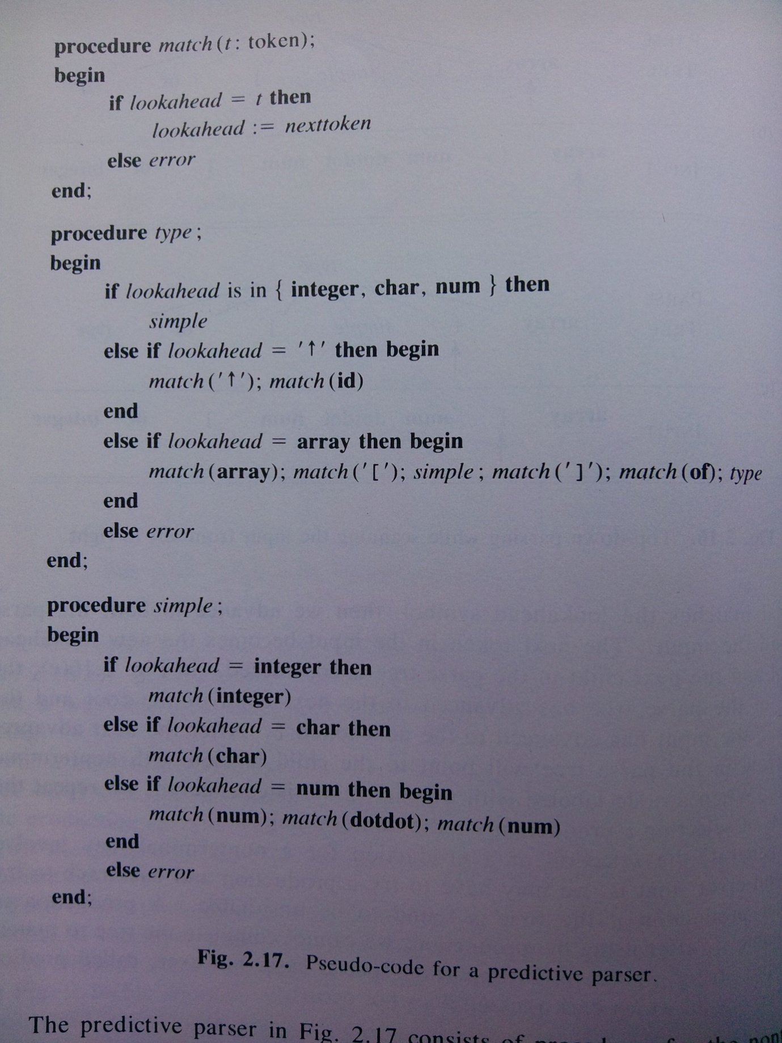
And here is the code
Walk-through “array [ 1..10 ] of char”
Notes:
See how stylized the code is: surely something automated could generate that…
<νυμβερ>

Slide 13
Write code for our first LL(1) parsing example
  E-> vT {v}
  E-> P(E) {f, (}
  P-> λ {(}
  P-> f {f}
  T->+E {+}
  T->λ {end-of input, )}

Slide 14
A more difficult grammar (introduced)
Terminals: {0,1,2,3,4,5,6,7,8,9,+,-, *, /, (, )}
Ultimately, our ‘compiler’ will parse infix and generate postfix: 9-5+2 -> 95-2+
Notes:
<νυμβερ>

Slide 15
Our initial solution
Start symbol: {expr}
Non-terminals: {expr, term}
Terminals: {0,1,2,3,4,5,6,7,8,9,-,+,*,/,(,)}
Production rules:
  expr->expr+term {0,…9}
  expr->expr-term {0,…9}
  expr->term {0,…9}
  term->0|1|2|3|4|5|6|7|8|9
But…

Slide 16
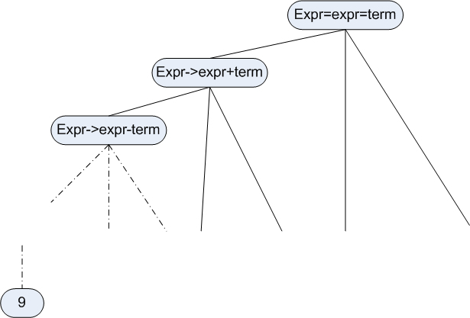
But there is a problem
When trying to break down an expr, we look ahead to see what the next input is – say a 9
But 9 can be the start of an expr, meaning that we could go down the expr->expr+term or expr->expr-term rule, leaving us
  back where we started wrt expr and
  breaking down expr again (and repeatedly forever)
Notes:
<νυμβερ>
Called the left recursion problem: when do we stop
we need to manipulate the grammar

Slide 17
More generally: the left recursive problem
A->Ac
A->a
A->b
A->λ
Ultimately ends up in L(G) like:
  accccc or bcccccccccccccc
Notes:
9-5+4
<νυμβερ>

Slide 18
More generally: the left recursive problem
A->Ac
A->a
A->b
Ultimately ends up in L(G) like:
  accccc or bcccccccccccccc
Fix
  A->N1 N2 {a, b}
  N1->a {a}
  N1->b {b}
  N2->c N2 {c}
  N2->λ {end-of input}
Notes:
9-5+4
<νυμβερ>

Slide 19
We need to adapt our grammar
expr -> term rest
rest -> + expr
rest -> - expr
rest -> λ
term -> 0
term -> 1
term -> …
term -> 9
Now do the look-ahead and run through 9-5+2
Notes:
9-5+4
<νυμβερ>

Slide 20
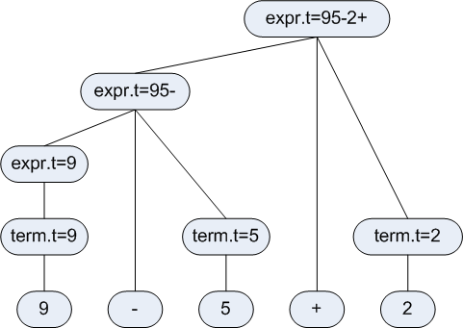
Aside 1(a): obtaining the associated values
CFG used to specify syntactic structure;
But each grammar symbol can have attributes and a set of semantic rules associated with each grammar can give value to those attributes;
Synthesized attributes are those attributes that are populated from the attribute values of children;
Usually
DFS;
Notes:
Other type of attributes: inherited attributes
Trace DFS through graph
Therefore code that implements parser has to go down through parse tree (or equally –sub non-terminals/terminals) as it encounters them and drag-up the attributes
<νυμβερ>

Slide 21
Aside 1(b)
Hence, code that implements parser has to go down through parse tree (or equally –sub non-terminals/ terminals) as it encounters them and evaluate semantic rules down there:
procedure visit(n:node);
begin
for each child m of n, left to right do
visit(m);
perform semantic rules of n
end
So… each non-terminal has a procedure associated with it to get these values, in this code parser

Slide 22
But still not perfect for postfix generation
(where do we put our processing)
expr -> term rest
(Option 1)
  term -> 0{printf(‘0’);}…
  rest -> - {printf(‘-’);} expr
  rest -> + {printf(‘+’);} expr
  rest -> λ
(Option 2)
  term -> 0{printf(0);}…
  rest -> - expr {printf(‘-’);}
  rest -> + expr {printf(‘+’);}
  rest -> λ
Notes:
Make SURE you do expression trees for these 2 instances to show grammar (option 1 and 2) wont work for both instances
<νυμβερ>

Slide 23
Suggested Solution
expr -> term rest
rest -> + term {printf(‘+’)} rest
rest -> - term {printf(‘-’)} rest
rest -> λ
term -> 0 {printf(‘0’)}
….
term -> 9 {printf(‘9’)}
Try:
  9-5+2 to show that the output now works
Then calculate the first set, follow set and predict set

Slide 24
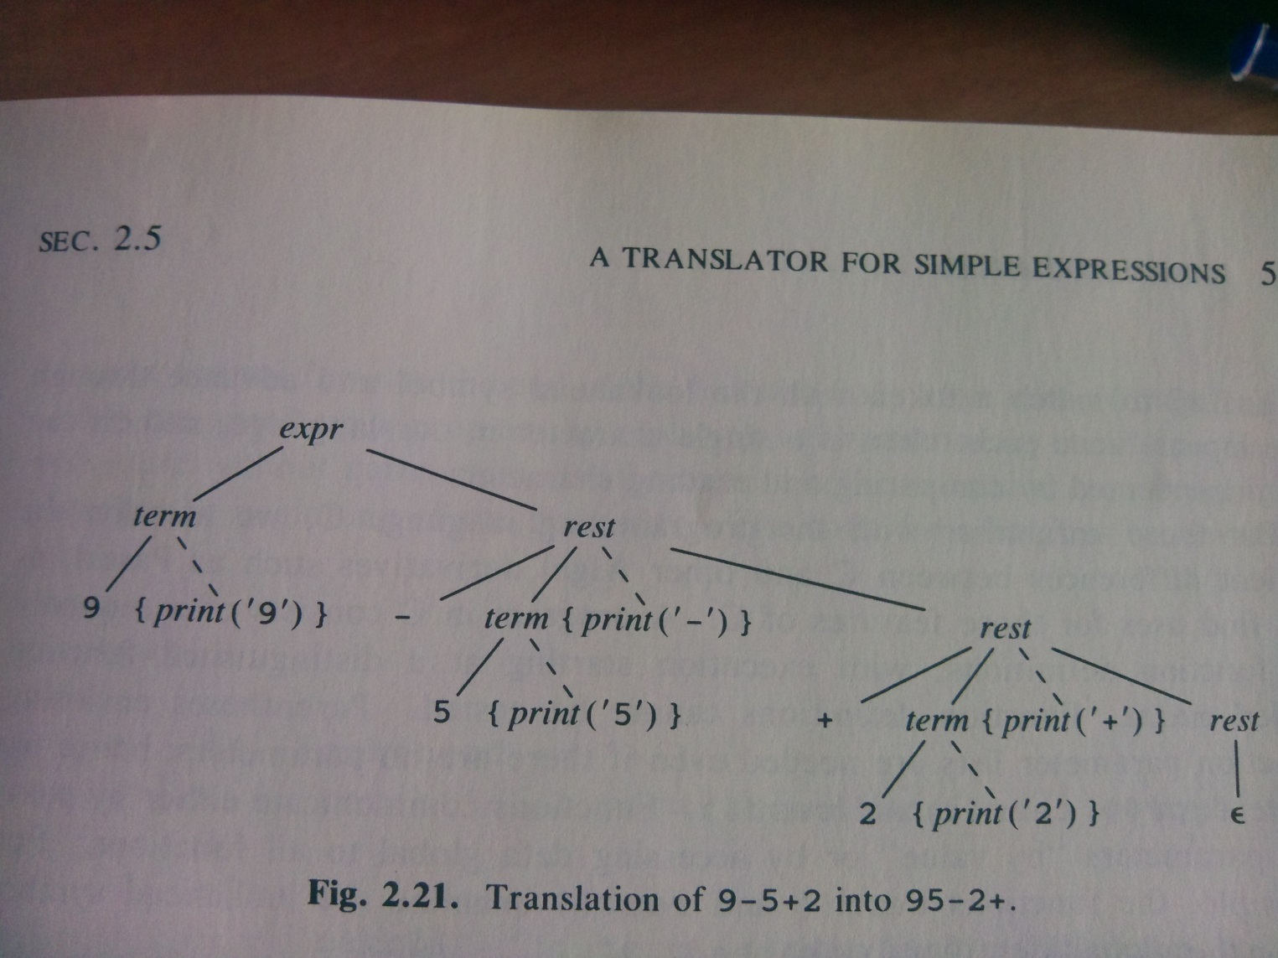
Resultant parse tree:
9-5+2

Slide 25
More generally, semantic intention can often involve grammar transformation, as can left recursion

Slide 26
Suggested Solution
expr -> term rest {0-9}
rest -> + term {printf(‘+’)} rest {+}
rest -> - term {printf(‘-’)} rest {-}
rest -> λ {ΕοΙ}
term -> 0 {printf(‘0’)} {0}
….
term -> 9 {printf(‘9’)} {9}

Slide 27
So now we can generate the pseudo-code
Each non-terminal has a procedure associated with it
In that procedure there is an case/switch determining which production rule to follow, based on the next token in the input stream and the next token that could be encountered via that production rule;
Inside the individual cases:
  Procedures associated with the non-terminals on the RHS of the rule, left to right, are called or;
  Matches of the terminals on the RHS of the rule, left to right are performed;

Slide 28
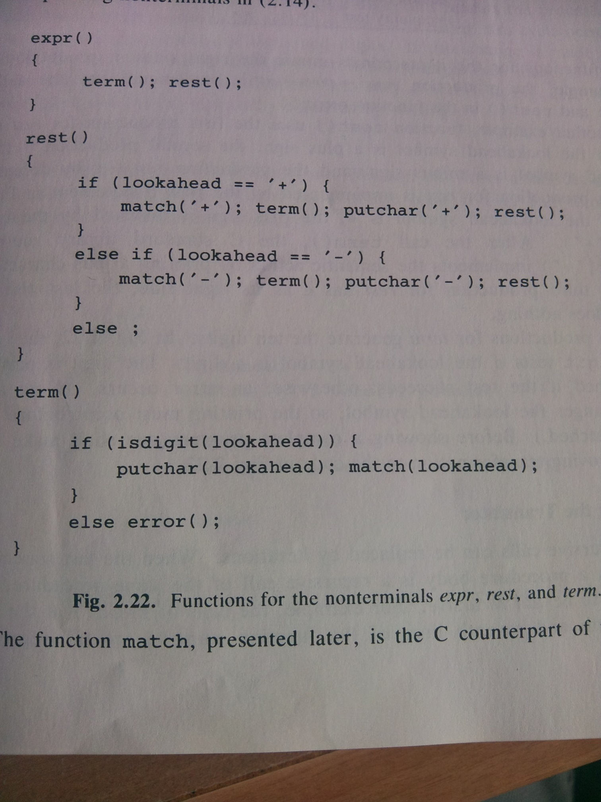
Postfix OP
Postfix OP
Generic handling of Digits
Notes:
The match procedure takes a parameter of type int (the look-ahead) and consumes it placing the next character in the lookahead: if(lookahead=parameter) then lookahead = getchar();
Remember though, this is only for +,-, not for all the grammar we want.
<νυμβερ>

Slide 29
Another ‘Making Grammars LL(1)’ problem
Common Prefixes:
  <stmt>=if <expr> then <stmt list> endif;
  <stmt>=if <expr> then <stmt list> else <stmt list> endif;
That is, they have Non-Disjoint Predict Sets;
Can you think of a solution…

Slide 30
Common Prefix Problem Soln
If-then-else problem
<ifstmt> -> if <expr> then <stmt list> <rest>
<rest> -> endif;
<rest> -> else <stmt list> endif;
void factor (Grammar *G)
{
while(G has 2 (or more) productions with common prefix)
{
let S={ A-> αβ,….., A-> αδ}
//A stands for the same V_{N}
// α stands for the common prefixmade of V_{N} and V_{T}
Create new V_{N} = N;
Replace S with S’;
S’={A->αN, N->β,…..,N->δ};
}
}

Slide 31
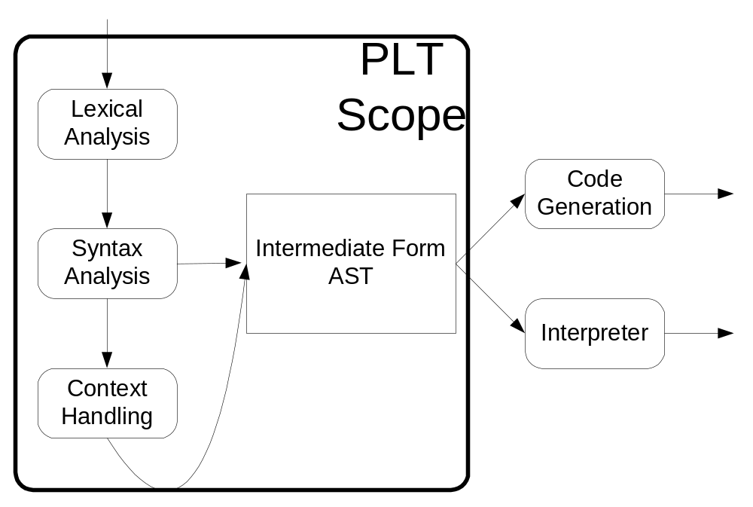
Before we go deeper into parsing…
Notes:
Compiler theory also need as an input the VTs and Vts are not always the next character: we need to be able to disambiguate words, identifiers, operators etc – Lexical analysis
<νυμβερ>

Slide 32
Lexical Analysis
Jobs to do:
  Remove white space
  Aggregate strings of numbers into a constant: we will type the resultant lexicons ‘num’
  Recognising keywords
  Recognising identifiers (here referred to as of type ‘id’)
  For each num and id, we need to store their value and name respectively, in a global variable;
The parser calls the lexer as it needs new tokens.
Notes:
Ours consumes input (numbers, white space) returning the token and the token value to the caller/parser.
Num is given the value 256 (above any character integer value)
<νυμβερ>

Slide 33
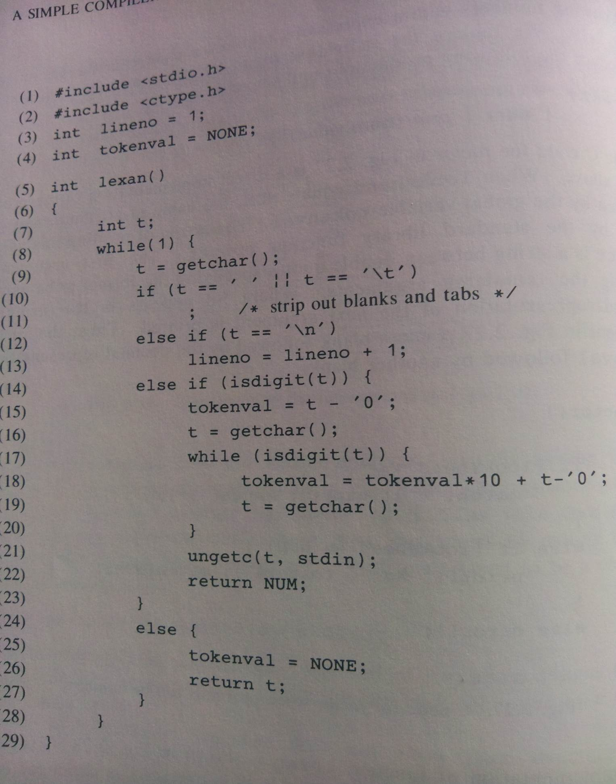
Lexer Code
Notes:
Lexer that ignores spaces/tabs, counts new lines and gathers numbers in tokenval
<νυμβερ>

Slide 34
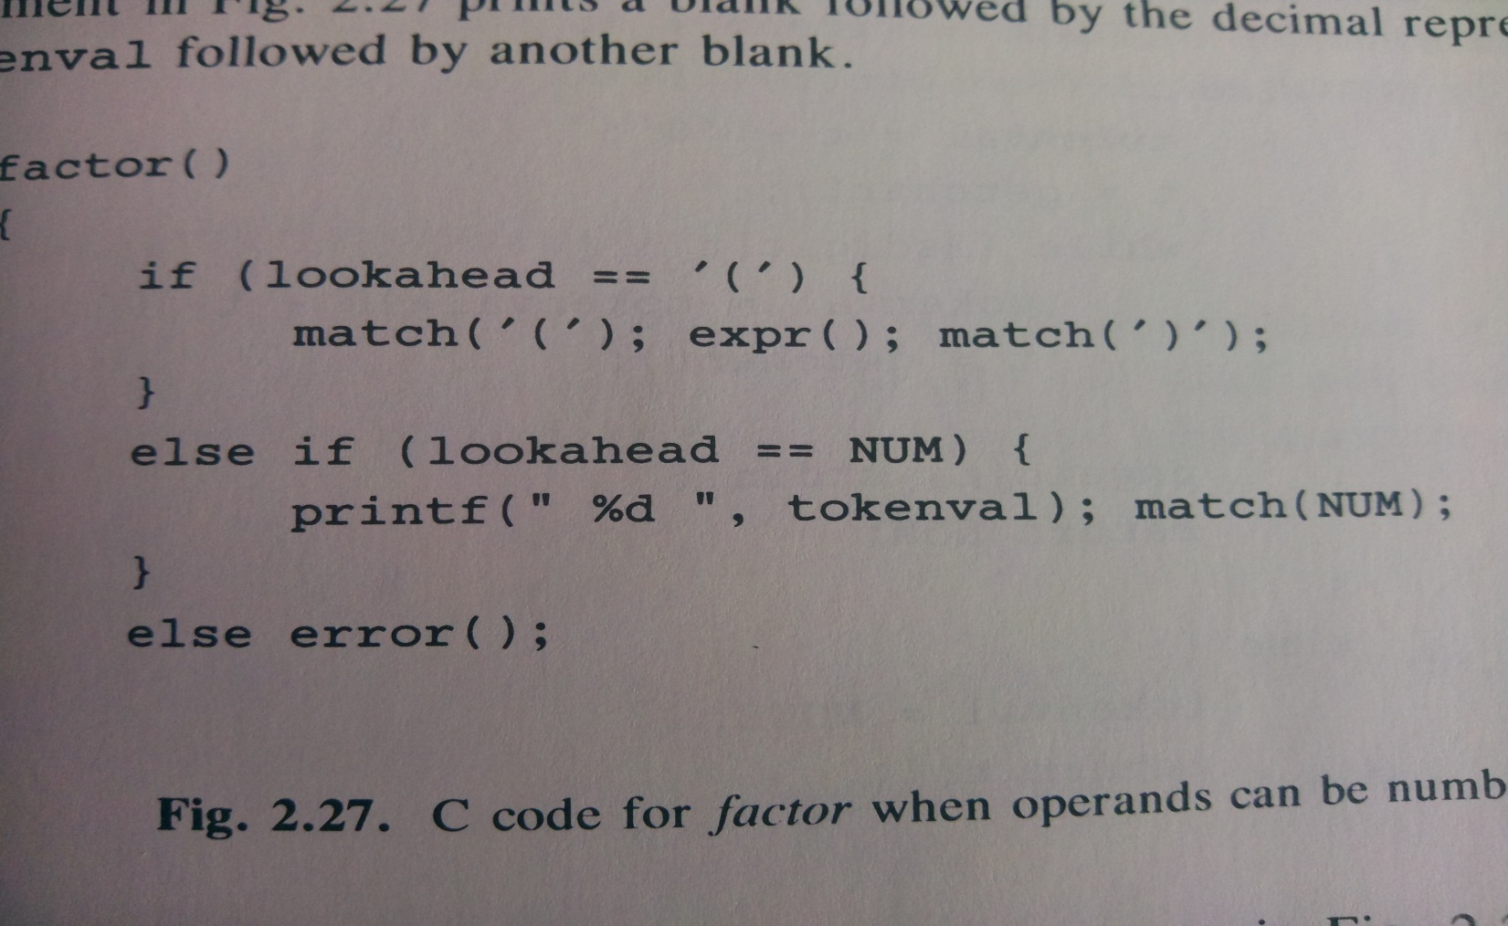
This involves changing the grammar
Individual terms (numbers) now become NUM types with value tokenval:
  term -> NUM {printf(“%d”, tokenval)}
  And an additional rule for ()s:
    term -> ( expr )
Notes:
They call it factor, but its term
<νυμβερ>

Slide 35
The Symbol Table
Often you need to
  Differentiate between a keyword and token
  Repeatedly refer to a token’s value
  Store other attributes (type)
So symbol table:
  Stores reserved words in advance
  Stores new identifiers (their types etc)
Presumes a:
  Lookup from the table that returns an index to the string
  Insert that inserts tokens and their attributes into the table
The full Lexer looks more like:
Notes:
For example, when a variable is used in a program, you have to check if its declared
For example, its type, its name, whether it refers to data, method, class etc.
<νυμβερ>

Slide 36
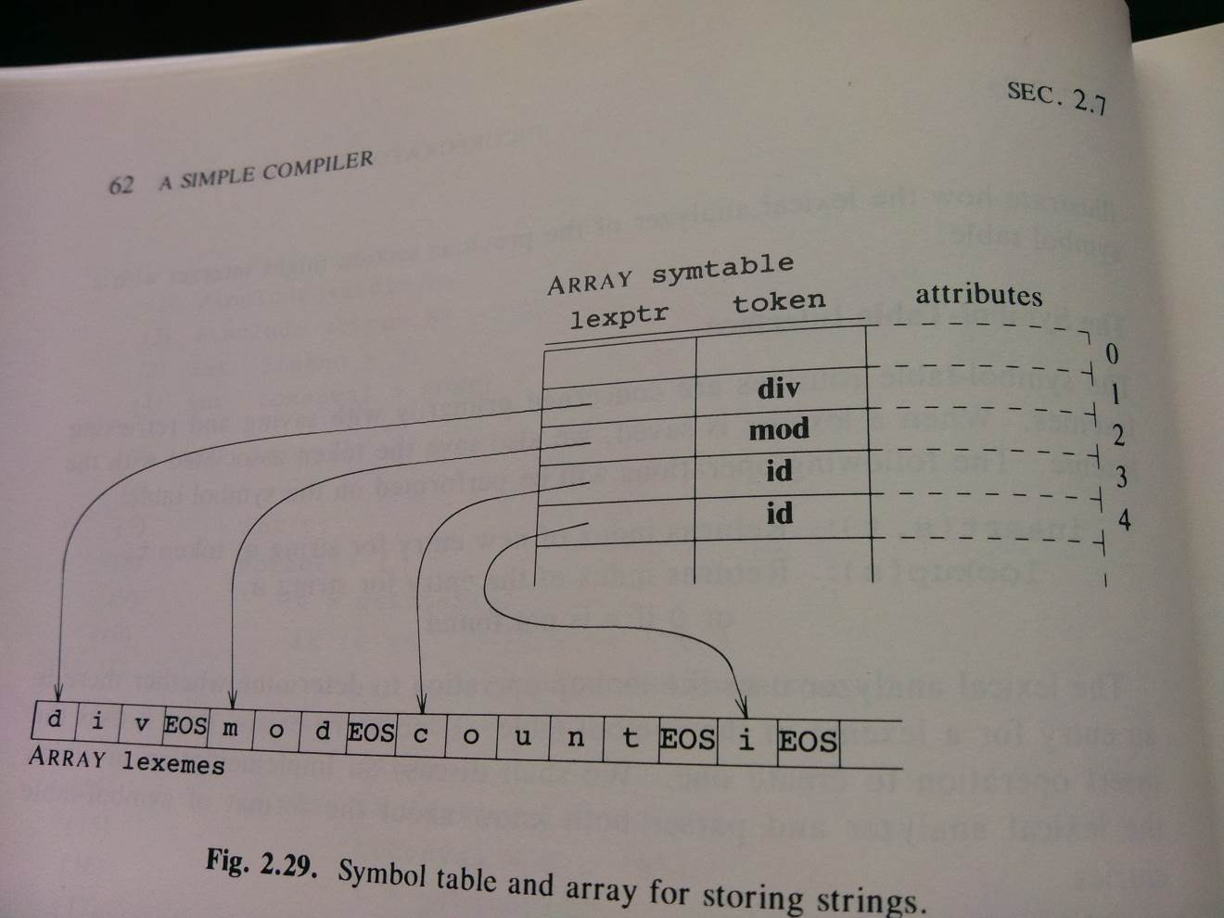
Symbol table

Slide 37
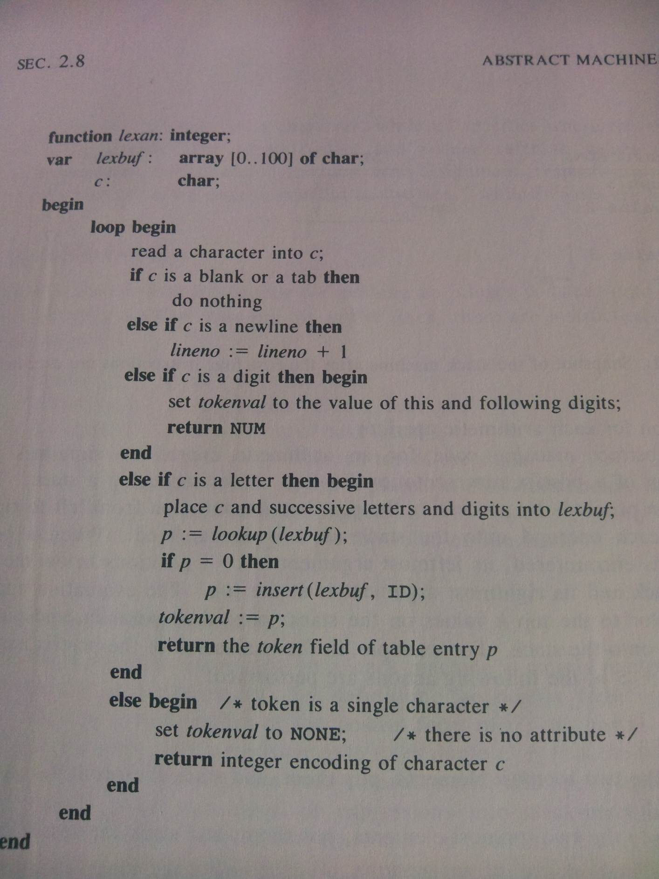

Slide 38
Your job (should you choose to accept it) is
To go through Aho and Ulman from pages 68-91 (attached – sections 2.5 to 2.7 inclusive)
See if you can “knit” how all these work together
To form an ‘Infix to Postfix’ translator, dealing with +, -, *, /, div and mod, and brackets
  http://ce.sharif.edu/courses/94-95/1/ce414-2/resources/root/Text%20Books/Compiler%20Design/Alfred%20V.%20Aho,%20Monica%20S.%20Lam,%20Ravi%20Sethi,%20Jeffrey%20D.%20Ullman-Compilers%20-%20Principles,%20Techniques,%20and%20Tools-Pearson_Addison%20Wesley%20(2006).pdf
  (This is a java version but the meaning is consistent);

Slide 39
Mid-Term
Worth 30%
1 hour
4 questions, do 3
  Everything up until now:
    Motivation/context, architecture, parsing lexical analysis…
    Structuring/Representation of mathematical expressions
    Generating strings with properties or mathematical expressions
    Grammar types;
    Deriving grammars from language instances, and language instances from grammars
    LL(1) parsing: parse trees, how-to, problems and automating;

Slide 40
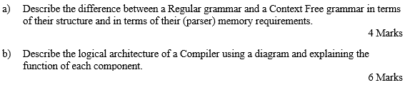
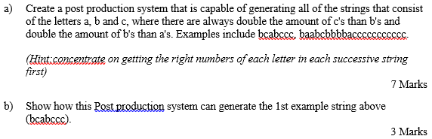
Mock questions
Notes:
Parsing is THE core element of this course!
<νυμβερ>

Slide 41
Lecture Summary
LL(1) parsing via the predict set.
The basis of generating code for recursive descent (predictive) parsers.
How stylized that code is – could a tool generate it if given the grammar?
LL(1) problems:
  Left recursion.
  Common prefix.
  Semantic intent
Additional lexer concerns.
Notes:
Basis of generating code:
Need to check on left recursion, common prefix, the output: higher priority operators lower down the parse tree, the operators come out at the right time
<νυμβερ>

